Slide 1
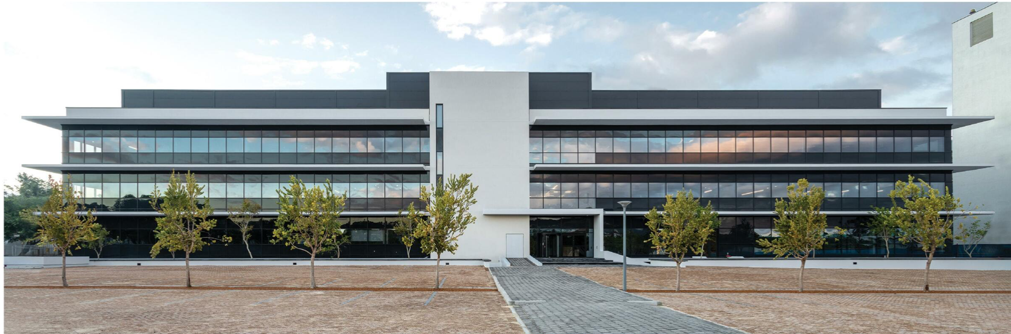

Human Population Genetics Workshop 2024
Local Ancestry Adjusted Allelic model (LAAA model)

Slide 2
Contents
Revision of the basic GWAS model
Building on the model
Admixture mapping
LAAA model
Demonstration

Slide 3
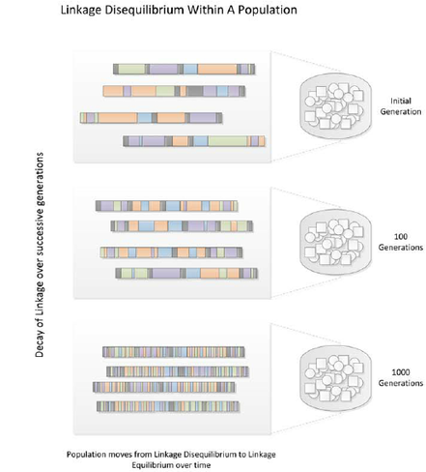
Theory before we start
Linkage disequilibrium
Linkage disequilibrium (LD) is the non-random association between alleles at separate but linked loci in a population (normally the result of the alleles lying within a common haplotype).
This means that these alleles are typically inherited together.

Slide 4
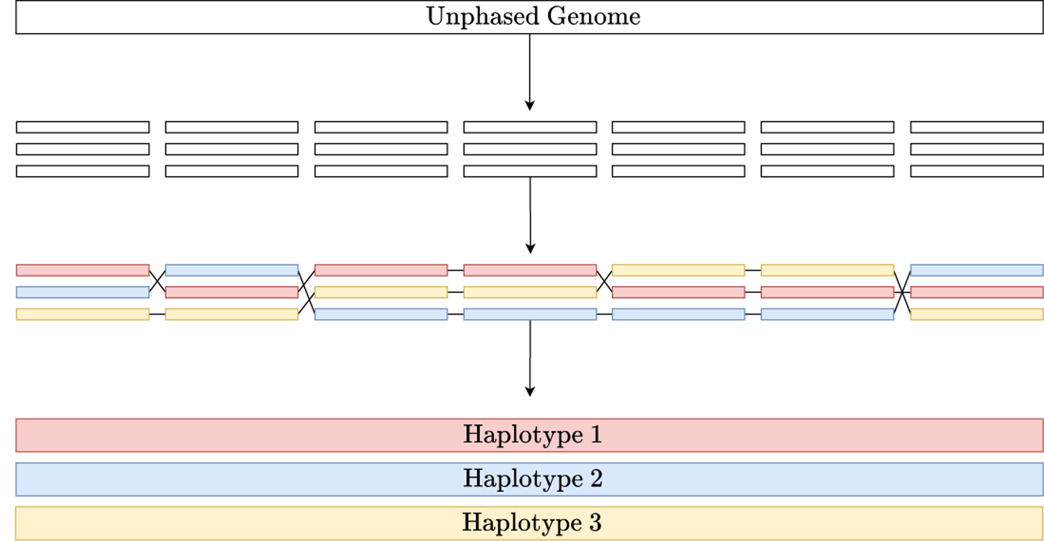
Theory before we start
Haplotypes
A haplotype is a series of alleles found at linked loci on a single chromosome.
Haplotype blocks are blocks of variants that are in LD with each other, but not with variants in adjacent blocks.
We can infer haplotypes computationally through phasing.

Slide 5
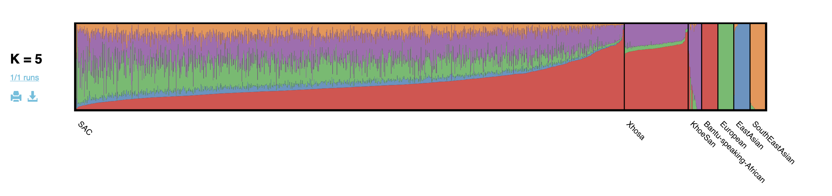
Theory before we start
Global ancestry
The contributions of different ancestral populations to an individuals’ genome, based on reference datasets of modern populations.

Slide 6
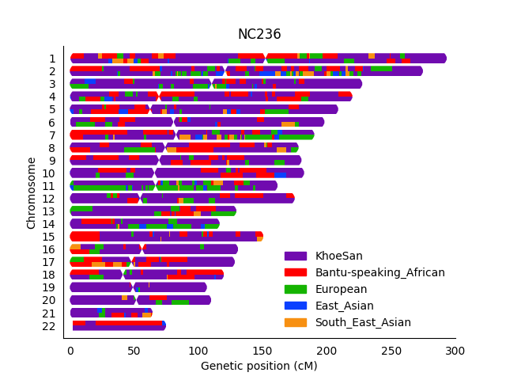
Theory before we start
Local ancestry
The genetic ancestry of specific chromosomal regions.
While global ancestry might indicate that someone is 70% African, and 30% European, local ancestry can identify which specific chromosomal segments come from African or European populations.

Slide 7
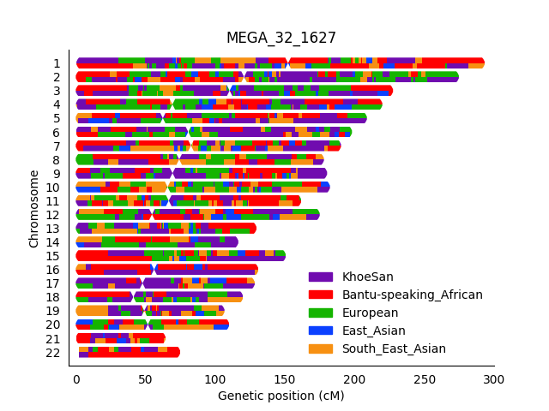
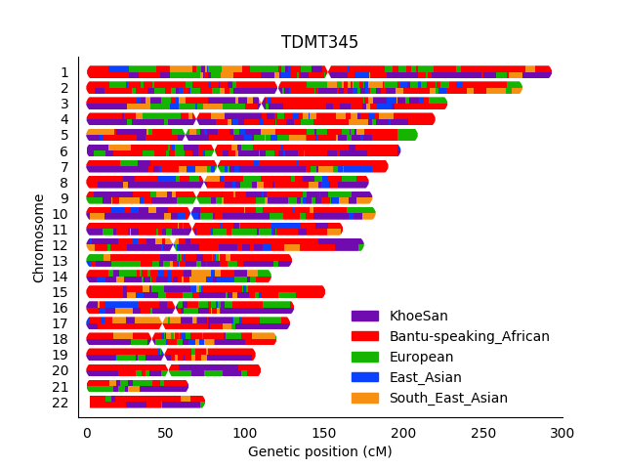
Local Ancestry
Local ancestry is highly heterogeneous – it varies across the genome and among individuals, even those with similar global ancestry proportions.

Slide 8
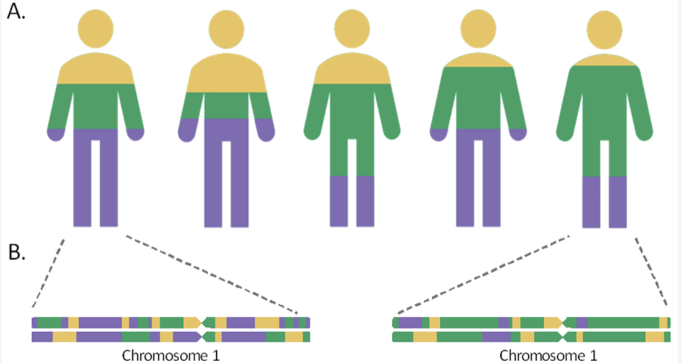
Local v. Global Ancestry

Slide 9
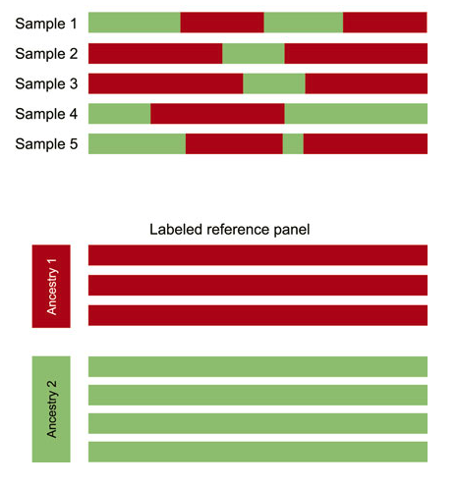
Steps for ancestry inference
Phase haplotypes
Genotype QC
WHY?
Remove SNPs with low genotype call rate
Remove samples with low genotype call rate
Remove monomorphic variants
Remove SNPs that deviate from HWE
ADMIXTURE
STRUCTURE
RFMix
TRACTOR
GNOMIX
Ancestry inference
Sample 1
Imputation
Sample 2
WHY?
Sample 3

Slide 10
Theory behind GWASs
Models and their meanings
The intercept
Reference/baseline risk
Log-Odds ratio
Outcome
[0 or 1]
$$Y= α_{0}+α_{1}E_{1}+α_{2}E_{2}+α_{P}P+βX$$
Risk alleles
[0, 1 or 2]
Covariates
Age, sex and ancestry proportions and their corresponding effect sizes
Notes:
Intercept: This provides the reference or baseline risk for the outcome before considering any additional genetic or environmental factors.

Slide 11
Theory behind GWASs
How do we code risk alleles?
Genotype | Allele 1 | Allele 2 | Dosage of genotype
Both reference alleles (homozygote) | 0 | 0 | 0
Both alternate alleles (homozygote) | 1 | 1 | 2
One reference and one alternate allele (heterozygote) | 0 | 1 | 1
One reference and one alternate allele (heterozygote) | 1 | 0 | 1
Notes:
The evolutionary changes described above can be statistically quantified by developing mathematical models of allele frequency dynamics.
To quantify this genetic variation in mathematical modelling, the major allele is coded as 0 and the minor allele as 1. Since one allele is inherited from each parent, the two alleles are added together to indicate the dosage of the alleles present at a specific genetic variant.
The aggregate properties of genetic variation can be mathematically and statistically quantified and biologically relevant conclusions can be extracted.

Slide 12
Theory behind GWASs
The GWAS Model
The intercept
Reference/baseline risk
Log-Odds ratio
Outcome
[0 or 1]
$$Y= α_{0}+α_{1}E_{1}+α_{2}E_{2}+α_{P}P+βX$$
Risk alleles
[0, 1 or 2]
Covariates
Age, sex and ancestry proportions and their corresponding effect sizes
Notes:
Intercept: This provides the reference or baseline risk for the outcome before considering any additional genetic or environmental factors.

Slide 13
Theory behind GWASs
How do we code local ancestry?
Ancestry | Allele 1 | Allele 2 | Dosage of genotype
Both are the ancestry of interest (e.g. homozygous African ancestry) | 1 | 1 | 2
Neither are the ancestry of interest (e.g. homozygous European ancestry) | 0 | 0 | 0
One allele is the ancestry of interest (e.g. heterozygous African ancestry) | 0 | 1 | 1
One allele is the ancestry of interest (e.g. heterozygous African ancestry) | 1 | 0 | 1
Notes:
The evolutionary changes described above can be statistically quantified by developing mathematical models of allele frequency dynamics.
To quantify this genetic variation in mathematical modelling, the major allele is coded as 0 and the minor allele as 1. Since one allele is inherited from each parent, the two alleles are added together to indicate the dosage of the alleles present at a specific genetic variant.
The aggregate properties of genetic variation can be mathematically and statistically quantified and biologically relevant conclusions can be extracted.

Slide 14
Theory behind GWASs
Admixture Mapping
The intercept
Reference/baseline risk
Log-Odds ratio
Outcome
[0 or 1]
$$Y= α_{0}+α_{1}E_{1}+α_{2}E_{2}+α_{P}P+β^{ancestry}X^{ancestry}$$
Covariates
Age, sex and ancestry proportions and their corresponding effect sizes
Local ancestry
[0, 1 or 2]
Notes:
Intercept: This provides the reference or baseline risk for the outcome before considering any additional genetic or environmental factors.

Slide 15
Theory behind GWASs
Ancestry plus allelic model
Allelic effect
$$Y= α_{0}+α_{1}E_{1}+α_{2}E_{2}+α_{P}P+β^{allelic}X^{allelic}+ β^{ancestry}X^{ancestry}$$
Covariates
Age, sex and ancestry proportions and their corresponding effect sizes
Ancestry effect
Notes:
Intercept: This provides the reference or baseline risk for the outcome before considering any additional genetic or environmental factors.

Slide 16
Theory behind GWASs
How do I make a model that tests for interactions between the allele and the local ancestry?
Notes:
Intercept: This provides the reference or baseline risk for the outcome before considering any additional genetic or environmental factors.

Slide 17
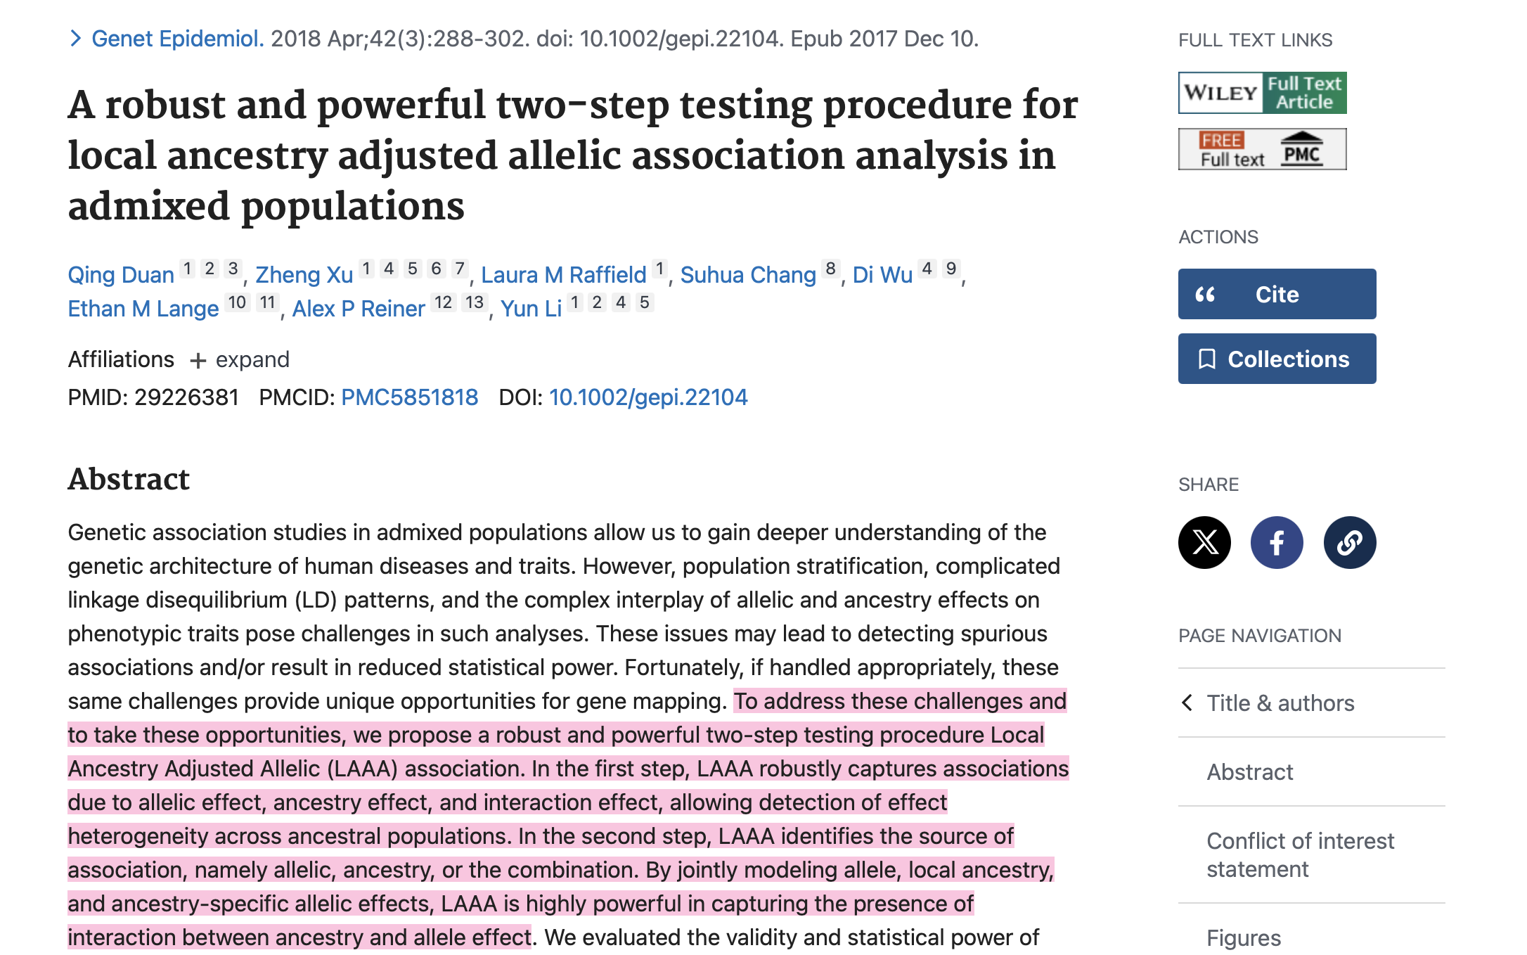
Theory behind GWASs
Notes:
Intercept: This provides the reference or baseline risk for the outcome before considering any additional genetic or environmental factors.

Slide 18
Theory behind GWASs
LAAA model
Combination of allelic+ancestry effects
Allelic effect
$$Y= α_{0}+α_{1}E_{1}+α_{2}E_{2}+α_{P}P+β^{allelic}X^{allelic}+ β^{ancestry}X^{ancestry}+ β^{allelic+ancestry}X^{allelic+ancestry}$$
Covariates
Age, sex and ancestry proportions and their corresponding effect sizes
Ancestry effect
Notes:
Intercept: This provides the reference or baseline risk for the outcome before considering any additional genetic or environmental factors.

Slide 19
Theory behind GWASs
How do we code this combination?
There are a few possible options for every locus:
Option 1
Locus being tested
Allele 1
A
Reference allele = A
Alternate allele = T
Ancestry of interest = Maroon
Allele 2
A
Individual does not have the alternate allele or the ancestry of interest at the locus being tested = 0
Notes:
The evolutionary changes described above can be statistically quantified by developing mathematical models of allele frequency dynamics.
To quantify this genetic variation in mathematical modelling, the major allele is coded as 0 and the minor allele as 1. Since one allele is inherited from each parent, the two alleles are added together to indicate the dosage of the alleles present at a specific genetic variant.
The aggregate properties of genetic variation can be mathematically and statistically quantified and biologically relevant conclusions can be extracted.

Slide 20
Theory behind GWASs
How do we code this combination?
There are a few possible options for every locus:
Option 1
Locus being tested
Allele 1
T
Reference allele = A
Alternate allele = T
Ancestry of interest = Maroon
Allele 2
A
Individual has the alternate allele but does not have the ancestry of interest at the locus being tested = 0
Notes:
The evolutionary changes described above can be statistically quantified by developing mathematical models of allele frequency dynamics.
To quantify this genetic variation in mathematical modelling, the major allele is coded as 0 and the minor allele as 1. Since one allele is inherited from each parent, the two alleles are added together to indicate the dosage of the alleles present at a specific genetic variant.
The aggregate properties of genetic variation can be mathematically and statistically quantified and biologically relevant conclusions can be extracted.

Slide 21
Theory behind GWASs
How do we code this combination?
There are a few possible options for every locus:
Option 1
Locus being tested
Allele 1
T
Reference allele = A
Alternate allele = T
Ancestry of interest = Maroon
Allele 2
T
Individual has the alternate allele but does not have the ancestry of interest at the locus being tested = 0
Notes:
The evolutionary changes described above can be statistically quantified by developing mathematical models of allele frequency dynamics.
To quantify this genetic variation in mathematical modelling, the major allele is coded as 0 and the minor allele as 1. Since one allele is inherited from each parent, the two alleles are added together to indicate the dosage of the alleles present at a specific genetic variant.
The aggregate properties of genetic variation can be mathematically and statistically quantified and biologically relevant conclusions can be extracted.

Slide 22
Theory behind GWASs
How do we code this combination?
Option 2
Locus being tested
T
Allele 1
A
Reference allele = A
Alternate allele = T
Ancestry of interest = Maroon
Allele 2
T
Individual has the ancestry of interest at the locus being tested and has the alternate allele, but the ancestry of interest and the alternate allele do not fall on the same haplotype = 0
Notes:
The evolutionary changes described above can be statistically quantified by developing mathematical models of allele frequency dynamics.
To quantify this genetic variation in mathematical modelling, the major allele is coded as 0 and the minor allele as 1. Since one allele is inherited from each parent, the two alleles are added together to indicate the dosage of the alleles present at a specific genetic variant.
The aggregate properties of genetic variation can be mathematically and statistically quantified and biologically relevant conclusions can be extracted.

Slide 23
Theory behind GWASs
How do we code this combination?
Option 2
Locus being tested
Allele 1
T
Reference allele = A
Alternate allele = T
Ancestry of interest = Maroon
A
Allele 2
T
Individual has the ancestry of interest at the locus being tested and has the alternate allele, but the ancestry of interest and the alternate allele do not fall on the same haplotype = 0
Notes:
The evolutionary changes described above can be statistically quantified by developing mathematical models of allele frequency dynamics.
To quantify this genetic variation in mathematical modelling, the major allele is coded as 0 and the minor allele as 1. Since one allele is inherited from each parent, the two alleles are added together to indicate the dosage of the alleles present at a specific genetic variant.
The aggregate properties of genetic variation can be mathematically and statistically quantified and biologically relevant conclusions can be extracted.

Slide 24
Theory behind GWASs
How do we code this combination?
Option 3
Locus being tested
T
Allele 1
T
Reference allele = A
Alternate allele = T
Ancestry of interest = Maroon
Allele 2
A
Individual has the ancestry of interest at the locus being tested and has the alternate allele on the same haplotype = 1
Notes:
The evolutionary changes described above can be statistically quantified by developing mathematical models of allele frequency dynamics.
To quantify this genetic variation in mathematical modelling, the major allele is coded as 0 and the minor allele as 1. Since one allele is inherited from each parent, the two alleles are added together to indicate the dosage of the alleles present at a specific genetic variant.
The aggregate properties of genetic variation can be mathematically and statistically quantified and biologically relevant conclusions can be extracted.

Slide 25
Theory behind GWASs
How do we code this combination?
Option 3
Locus being tested
T
Allele 1
T
Reference allele = A
Alternate allele = T
Ancestry of interest = Maroon
A
Allele 2
T
Individual has two loci of the ancestry of interest at the locus being tested and has two alternate alleles on the same haplotype = 2
Notes:
The evolutionary changes described above can be statistically quantified by developing mathematical models of allele frequency dynamics.
To quantify this genetic variation in mathematical modelling, the major allele is coded as 0 and the minor allele as 1. Since one allele is inherited from each parent, the two alleles are added together to indicate the dosage of the alleles present at a specific genetic variant.
The aggregate properties of genetic variation can be mathematically and statistically quantified and biologically relevant conclusions can be extracted.

Slide 26
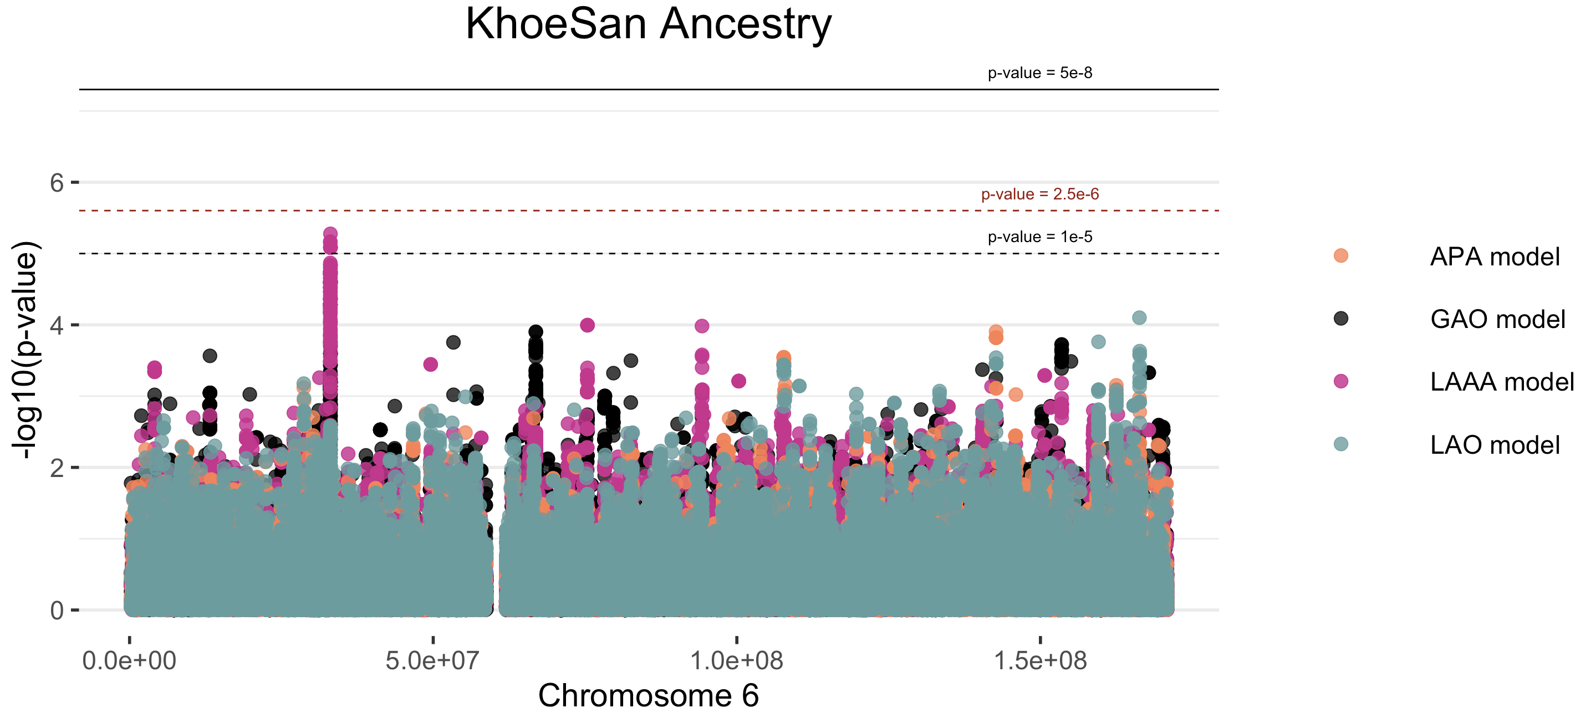
Manhattan Plot

Slide 27
Preparing the files - Demonstration

Slide 28
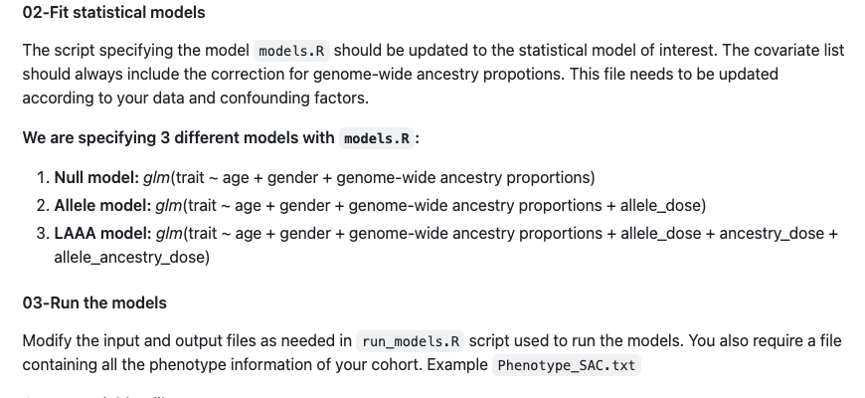
Running models
https://github.com/TBHostGenetics/LAAA-model

Slide 29
Running the LAAA models - Demonstration

Slide 30
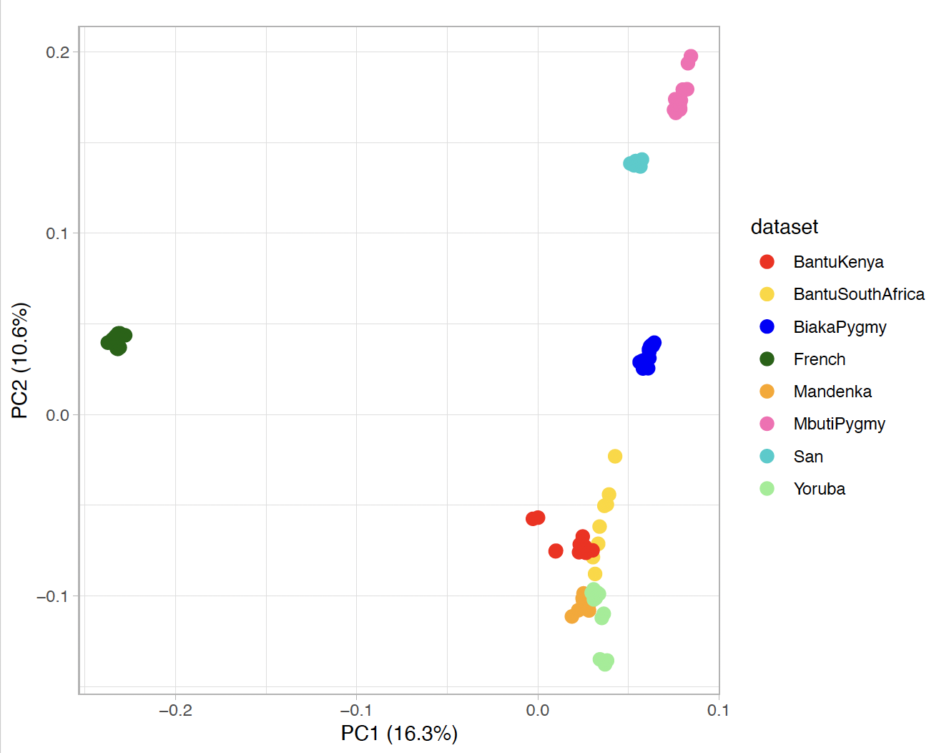
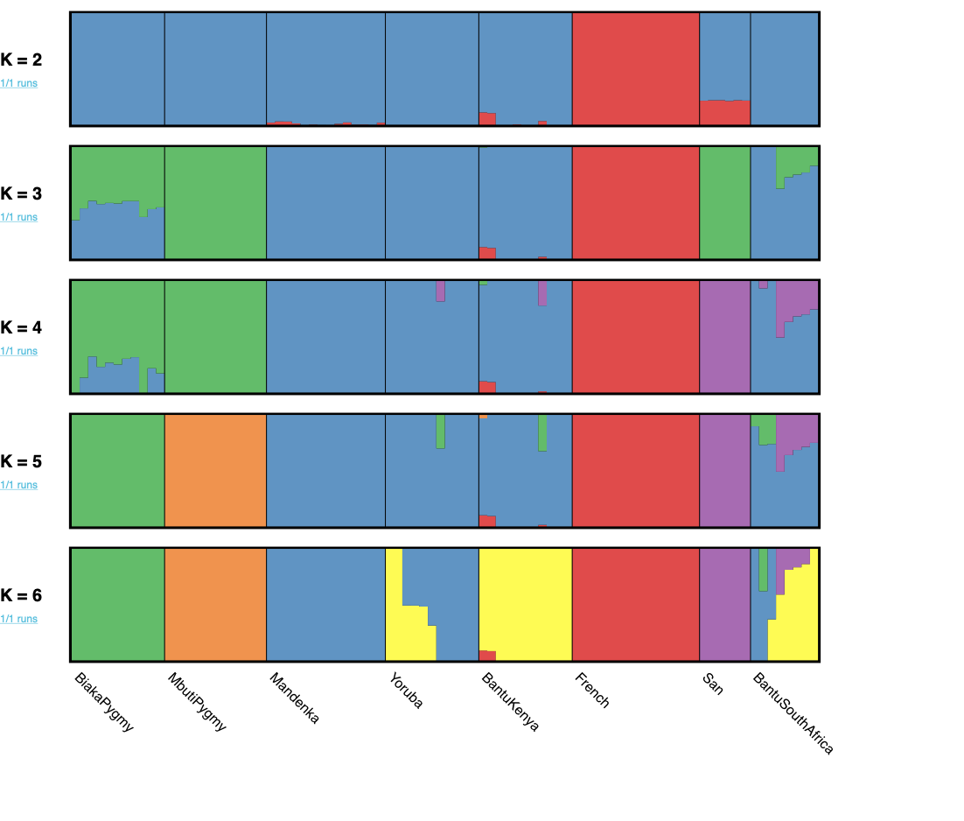
Revise our data’s global ancestry proportions

Slide 31
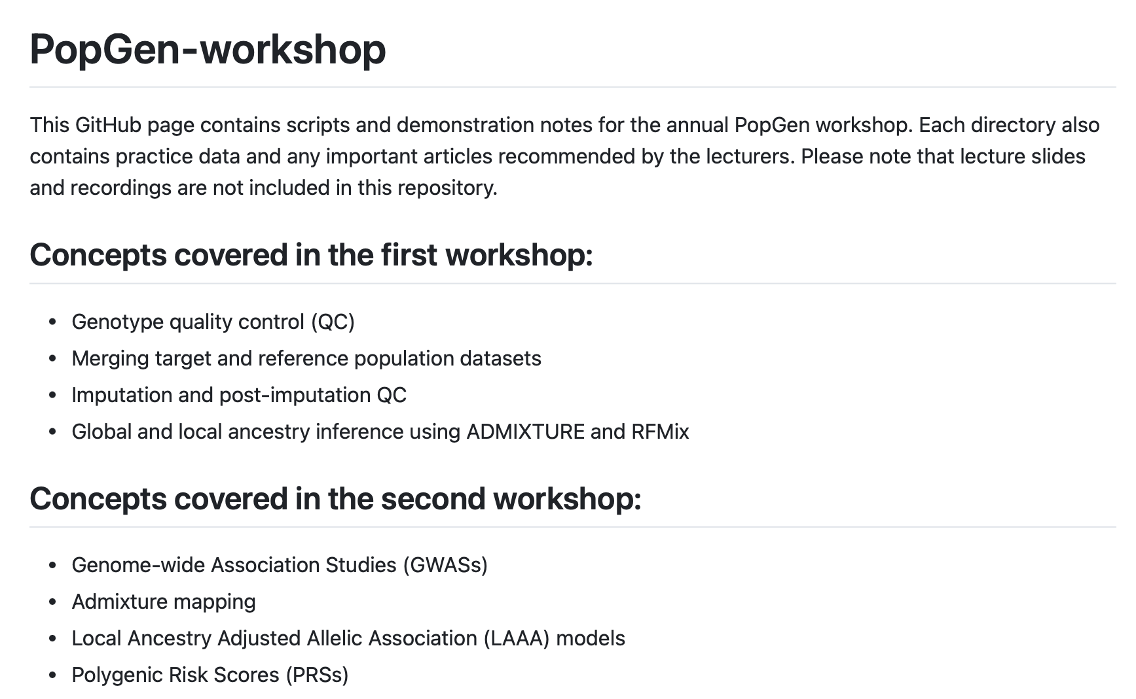

PopGen-workshop GitHub page
https://github.com/TBHostGenetics/PopGen-workshop

Slide 32
Recommended reading
Duan Q, Xu Z, Raffield LM, Chang S, Wu D, Lange EM, Reiner AP, Li Y. A robust and powerful two-step testing procedure for local ancestry adjusted allelic association analysis in admixed populations. Genet Epidemiol. 2018 Apr;42(3):288-302. doi: 10.1002/gepi.22104. Epub 2017 Dec 10. PMID: 29226381; PMCID: PMC5851818.
Swart Y, Uren C, van Helden P, Hoal E and Möller M (2021) Local Ancestry Adjusted Allelic Association Analysis Robustly Captures Tuberculosis Susceptibility Loci. Front. Genet.12:716558. doi: 10.3389/fgene.2021.716558.
Swart Y, van Eeden G, Uren C, van der Spuy G, Tromp G, et al. (2022) GWAS in the southern African context. PLOS ONE 17(9): e0264657.https://doi.org/10.1371/journal.pone.0264657.
Croock D, Swart Y, Schurz H, Petersen D, Möller M and Uren C (2024) Confirmation of HLA-II associations with TB susceptibility in admixed African samples. eLife. 13:RP99200. https://doi.org/10.7554/eLife.99200.2.

Slide 33

Thank you
Enkosi
Dankie
Photo by Stefan Els
Notes:
Cover & End Slide Option
Replace the background image: Right-click on the slide, then choose Format Background and select Picture or texture fill. Select a new picture of your choice.
Remember to add an image attribution for e.g., Photo by Stefan Els.

